Slide 1
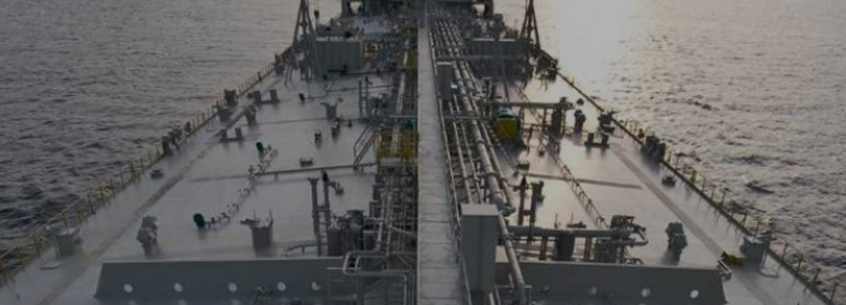
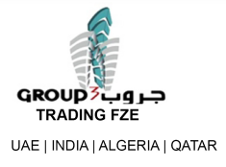
A leader in petroleum and energy commodities trading
Partnering with oil & gas producers, refineries and
Petrochemical plants
Serving a global market

Slide 2
ABOUT US
Group 3 Trading FZE (G3) is established in United Arab Emirate (UAE) and has global market coverage through its network of affiliates and agencies in Middle East and Asia Pacific Region. It has become one of the leading international trading companies in the trading of energy and petroleum commodities, and petrochemical products. The excellent business background has brought us the opportunity to collaborate/register as the principal re-seller in several oil majors, refineries and petrochemical plants in the Middle East, Russia, Africa continent, Libya, Asia Pacific etc.
Over the years, our strong partnership with oil & gas producers, refineries and petrochemical plants in the supply chain network enable us to offtake from their production to ensure competitive long term security of consistent supply needs of the products to end buyers/customers, providing 247 CIF delivery services promptly.
G3 is well positioned and financed to service the growing energy needs both globally and in the Asia Pacific Region. The company transacts with a range of clients, from oil industry majors to smaller independent producers and refiners, and oil and energy traders.

Slide 3
Affiliation
Group3 Trading FZE is an affiliate and trading house of Group3 Trading & Contracting Company
Group3 Trading & Contracting Company
Group3 Trading And Contracting Company is based in United Arab Emirate (UAE),Qatar with affiliates in India, Algeria, Singapore and Malaysia.
The groups core business is mainly engaged in project development, construction and trading in the field of oil & gas, property and infrastructure projects. We are grade A general contractor who had successfully delivered multi millions projects in Qatar, UAE and Algeria. We are expanding our reach in Asia Pacific Region like India, China, Indonesia, Singapore, Malaysia, Sri Langka etc.
Group3 was founded by its Chairman/Group Managing Director, Mr. Peer Mohamed, whose dynamic leadership quality and vast hands-on experience in international trade, finance and construction is behind the success stories of Group3. Mr. Peer has accumulated over 35 years of services and business track records in the gulf countries, middle east, asia pacific region and African countries.

Slide 4
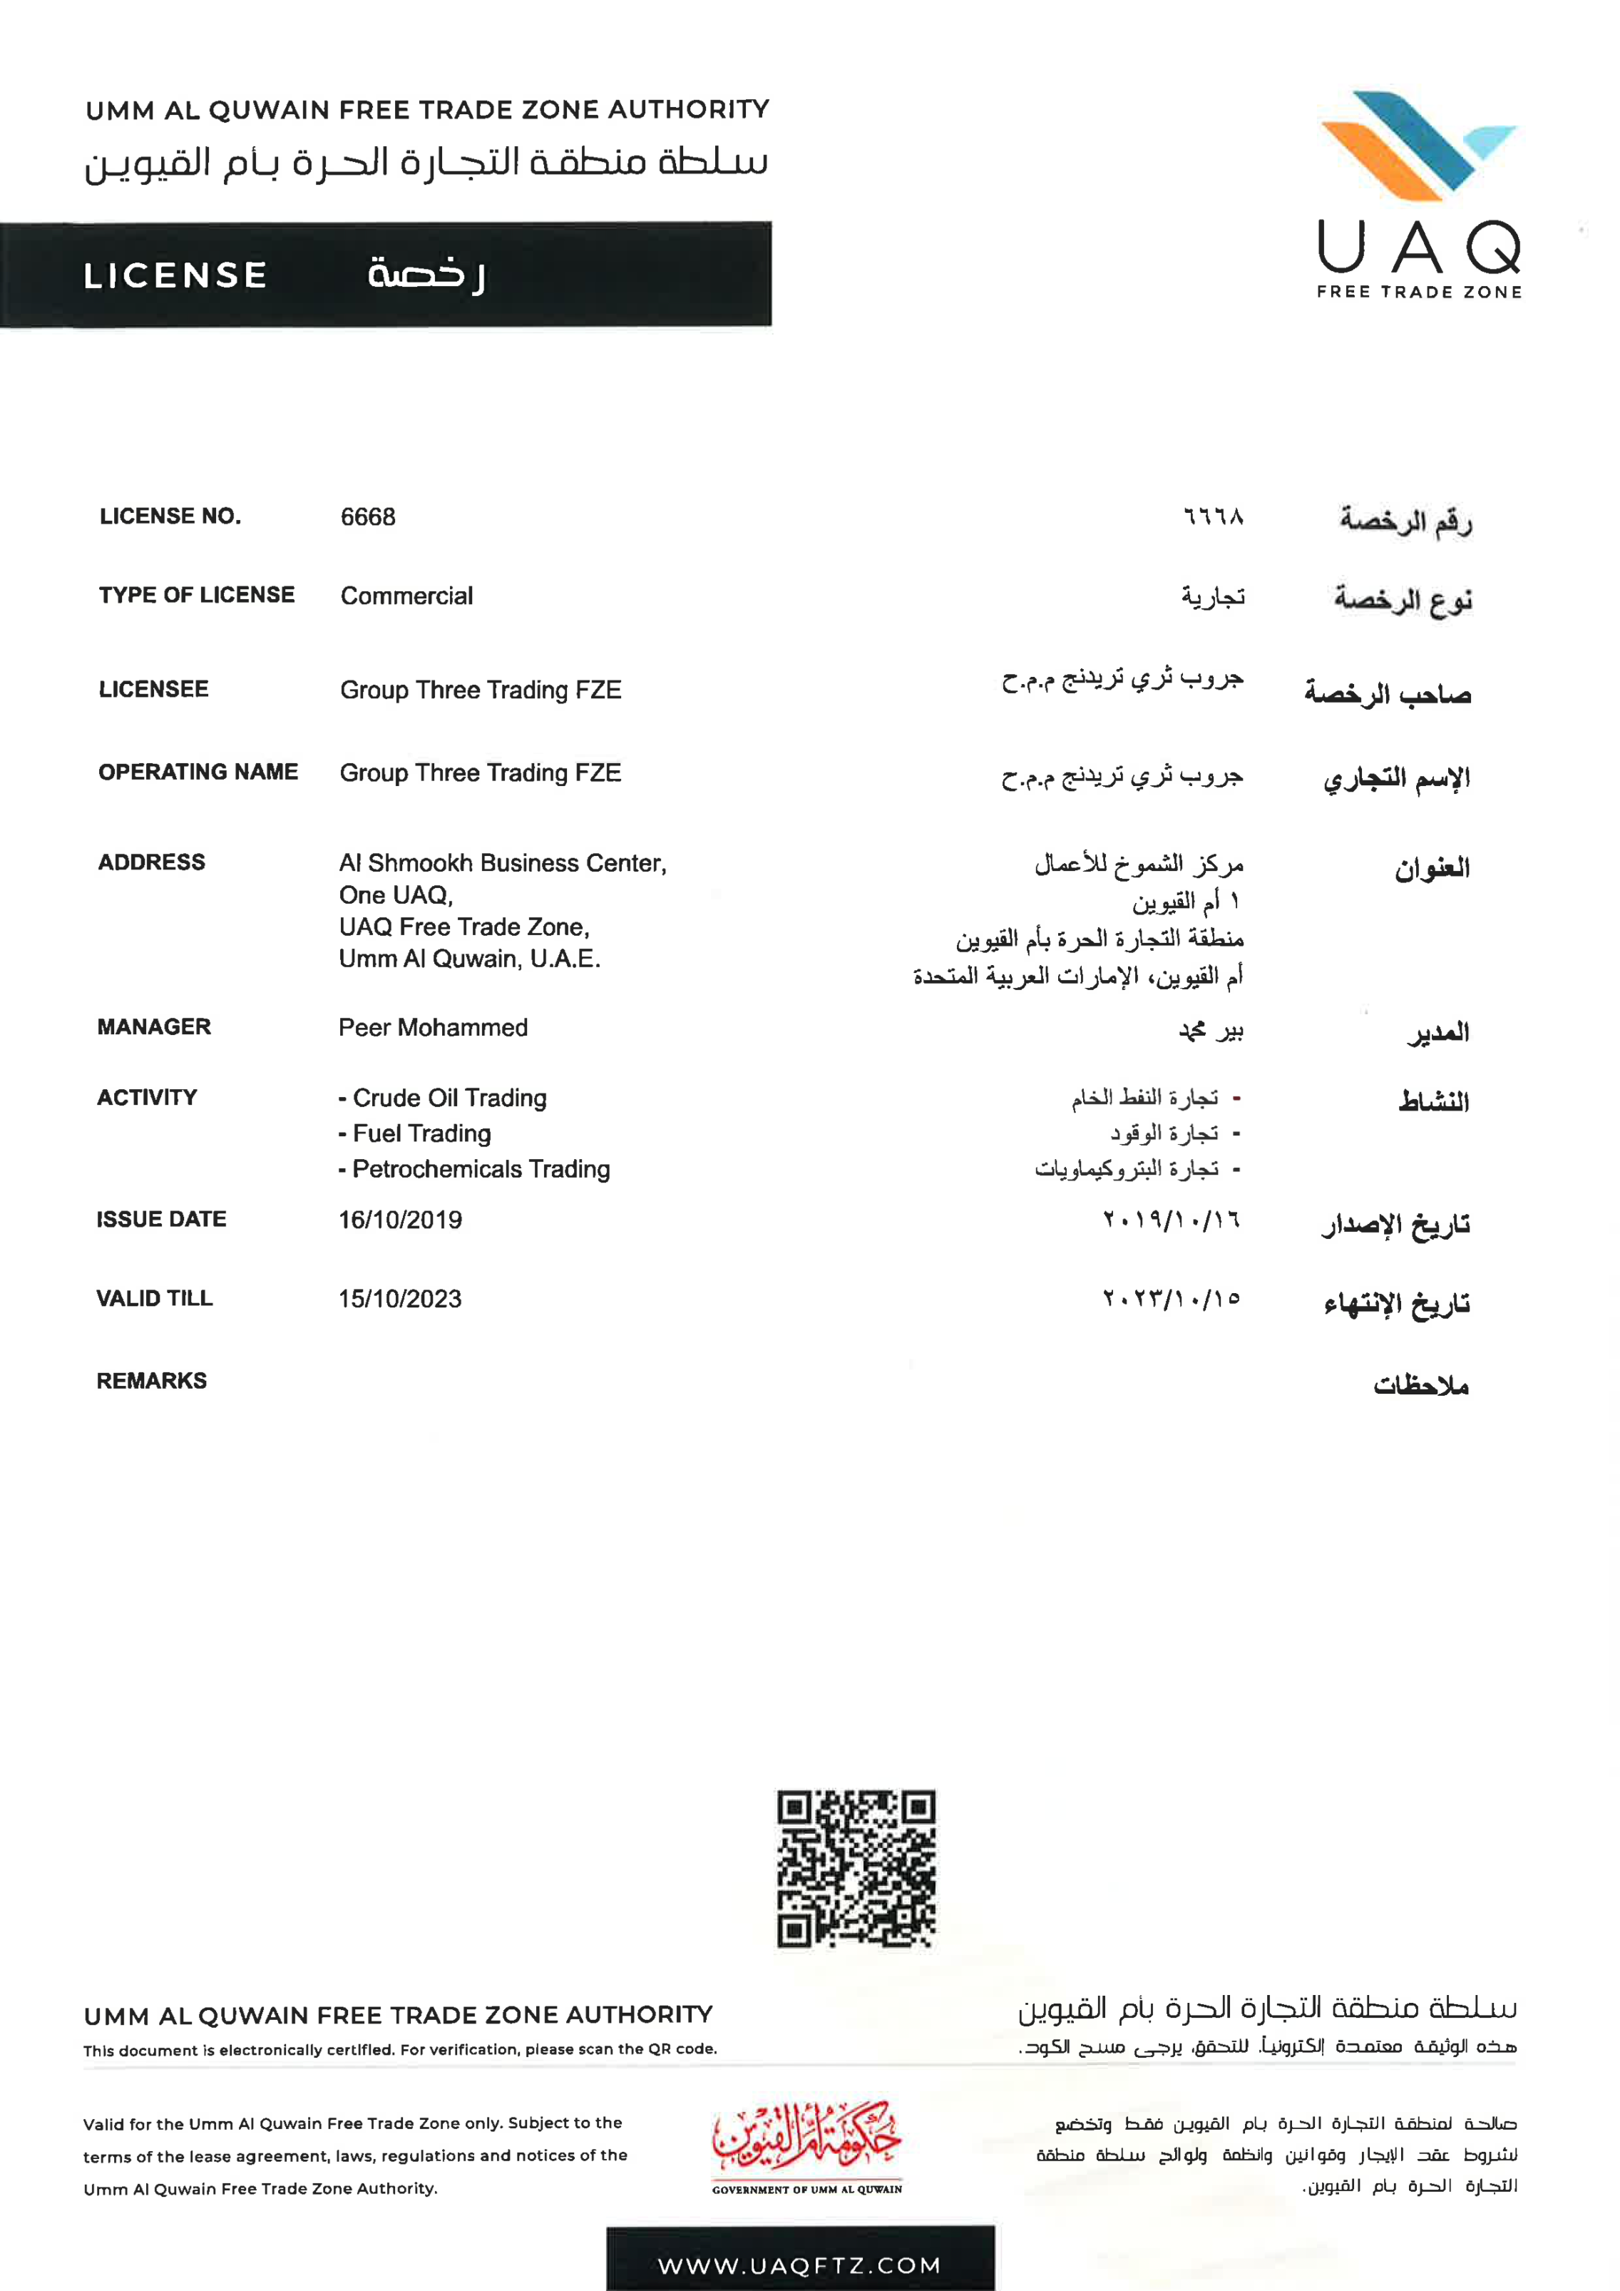
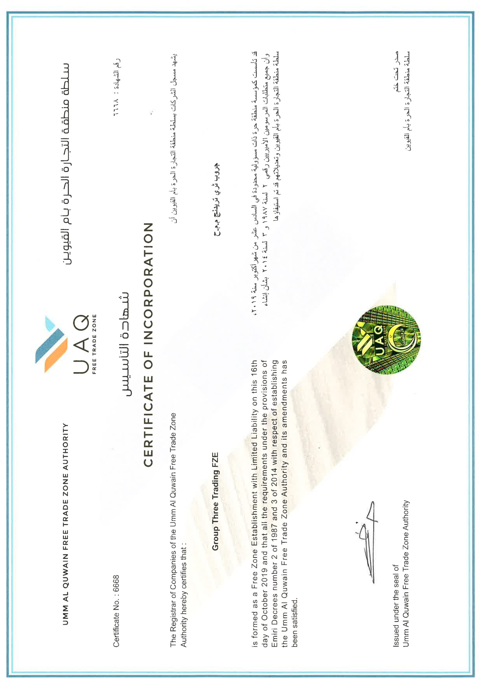
Trading License for energy & petroleum trading

Slide 6
Partnering with oil & gas producers, refineries
and petrochemical plants
We have direct access to major producers/refineries/petrochemical plants in Russia, Middle East and other countries. Our representatives stay close to your shipment from pick-up to delivery, keeping you closely informed of its progress.
MIDDLE EAST & Russia
Project Development Oman (PDO)
Qatar Gas/Rasgas (LNG)
Emirates National Oil Company (UAE}
Tuapaz Refinery
Bashneft
ASIA PACIFIC
Ceylon Petroleum Corporation
Bharat Petroleum Corporation, India.
China National Petroleum Company
Pertamina Indonesia
Petronas Malaysia
SRC Singapore

Slide 7
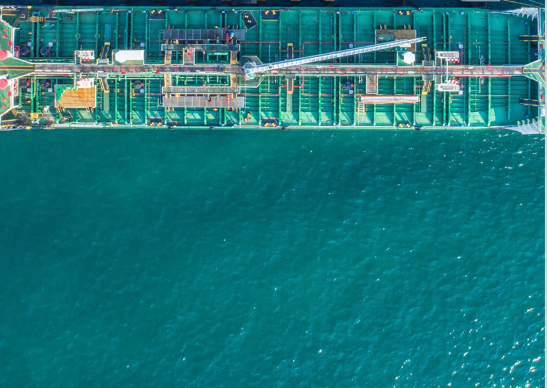
G3 is primarily engaged in the trading of following energy & petroleum products and medical PPEs:-
Liquefied Petroleum Gas (LPG)
Gasoline/Gas Oil
Furnace Oil
CST-180 Fuel Oil
SN 500 Base Oil
Petrochemicals
Urea N46%
Petroleum Coke
Bitumen Grades 40/50, 60/70. 80/100
Light, Medium and Heavy Crude Oil
Mazut 100 Gost 10585/75/99
Liquefied natural gas (LNG)
Napththa
Aviation Kerosene Colonial Grade 54 Jet Fuel
Jet Fuel JP-A1.
All types of Diesel Fuel EN-590,
Diesel D2 Gost 305-82
Market Capitalization : Consolidated as

Slide 8
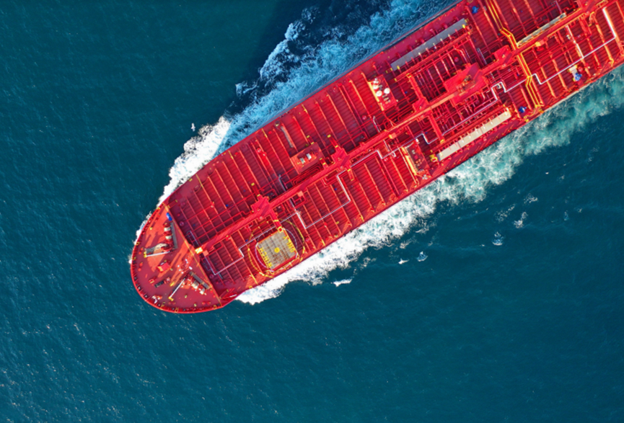
Our focus is to help end-buyers, and direct-suppliers close bulk transaction deals successfully.
We draw on the strengths of experience, resources, global supply capability and significant strategic partnerships with producers, suppliers, customers to create a highly capable network of supply chain for energy and petroleum products. G3’s supply business utilizes a highly efficient network of manufacturing facilities and shipping transportation/logistic systems to deliver products on CIF basis promptly and efficiently with 247 services to our customers around the world.
This diversity of distribution channels, specifically developed to supply a variety of sought after commodities to established Buyers and Traders in the Commodity Industry, is our key business strengths
Our delivery strictly adhere to international rules and procedures including UCP600, UCR522 and Incoterms® Latest, using easy to follow guidelines found in the URPIB Rules of Trade.

Slide 9
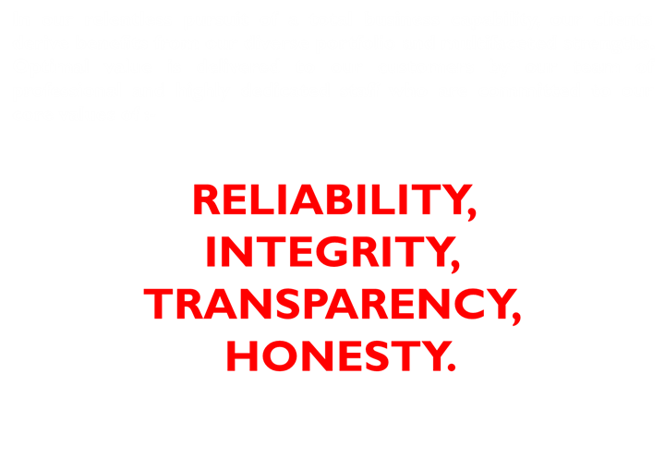
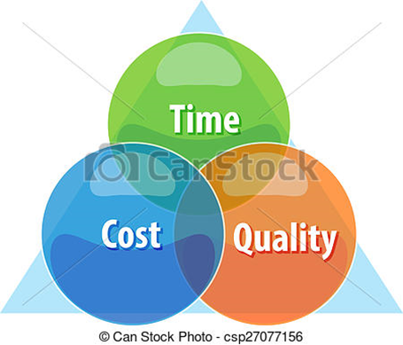
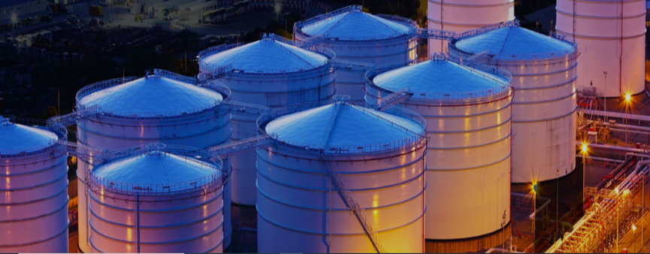

Slide 10
For more information, please contact us to find out how we can help deliver innovative, inspiring and sustainable solutions that set new standards and benefit our customers:
Group Three Trading Fze
UAQFTZ, Al-Shmookh Tower
UAQ, United Arab Emirates.
operations@group3trading.com

